Slide 1

Factor Analysis of Electric Vehicle Adoption

Slide 2
Problem
The transportation sector is one of the largest contributors to greenhouse gas emissions, and the adoption of electric vehicles (EVs) is seen as a key strategy to reduce these emissions. Washington State has set ambitious goals for EV adoption, but there is still a lot of work to be done to meet these targets.

Slide 3
Aim
Analyze and understand the factors driving EV adoption in Washington State, and to provide recommendations for how to promote EV adoption in the state.
▪ Depends on the datasets we have, there are several objectives that can be analyzed, such as:
– Understand the trends and patterns of EV adoption in Washington State.
– Understand the characteristics of EV owners and how they differ from non-EV owners.
– Identify the factors that are driving EV adoption in Washington State, such as government policies, availability of charging infrastructure, and consumer preferences.
– Provide recommendations for how to promote EV adoption in Washington State based on the findings from the analysis – etc.

Slide 4
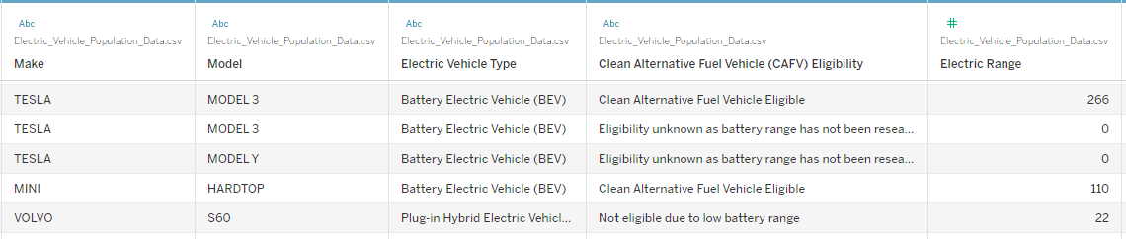
Progress
Familiarizing with the data set
Key information from the data set
Make
Model
Year
Electric Range
Clean Alternative Fuel Vehicle Eligibility
Clean Alternative Fuel Vehicle Eligibility
Clear Alternative Fuel Vehicle Eligible
Not eligible due to low battery range
Eligibility unknown as battery range has not been researched

Slide 5
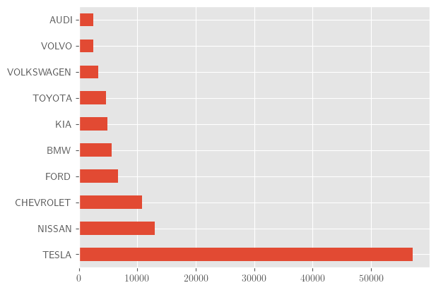
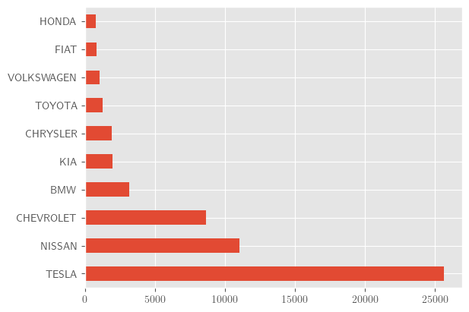
Progress
Consumer preferences
1. Top 10 EV manufacturers
Clear Alternative Fuel Vehicle Eligible

Slide 6
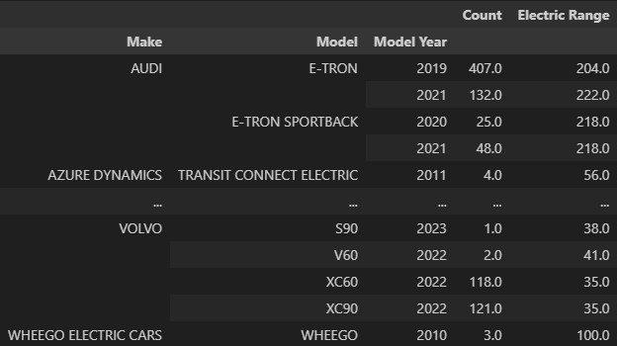
Progress
Consumer preferences
2. Range
Positive correlation between car ranges and units sold per each model.
0.17 if all record included
0.45 considering only Clear Alternative Fuel Vehicle Eligible

Slide 7
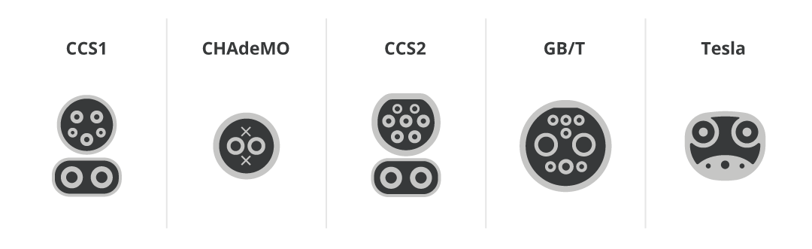
What’s next
Why Tesla has highest amount of units sold? What features does this manufacturer offer that other don’t?
Charger types and their charging speeds
Charging port Standardization
Government policies, tax incentives.
Price diversity Between EV vs Non-EV

